Slide 1


IMDB Movie Analysis
By Rajat Panwan

Slide 2
Project Description
The aim of this project is to perform an analysis on a dataset containing information on various movies from IMDB. The dataset includes columns such as the director name, gross, genres, movie title, num voted users, plot keywords, num user for reviews, language, rating, budget, IMDB score etc. The main objective is to extract useful insights from the data and identify any trends or patterns that can be useful for decision-making.

Slide 3
Approach
The project involved several steps including data cleaning, data visualization, and statistical analysis. Initially, the dataset was explored to identify any missing values, outliers, or errors. The data was then cleaned using various techniques such as removing duplicates and correcting errors. Data visualization tools were used to create charts, graphs, and histograms to analyze the data.

Slide 4
Tech-Stack Used
The project was performed using Excel version 2021. Excel was chosen for its powerful data analysis and visualization capabilities. It is also widely used in the industry and provides a familiar environment for users.

Slide 5
Insights
Several useful insights were obtained from the analysis. For example, Jurassic World has made the highest profit . The analysis also showed that movies Shawshank Redemption is highest rated movie on IMDb. Another interesting finding was that movies directed by Cary Bell and Akira Kurosawa tended to have higher ratings than others. The analysis also identified certain genres that were more popular than others.

Slide 6
Result
The project was successful in identifying several useful insights from the data. These insights can be useful for decision-making in the movie industry. Results are on next pages.

Slide 7


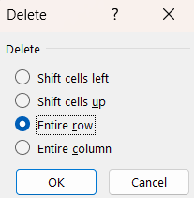
Result
A. Cleaning the data: This is one of the most important step to perform before moving forward with the analysis. Use your knowledge learned till now to do this. (Dropping columns, removing null values, etc.)
Your task: Clean the data
Deleted the column which are not required in our analysis.
Then delete all the rows that have bank values in any rows.
After deleting only 3956 rows are left.

Slide 8
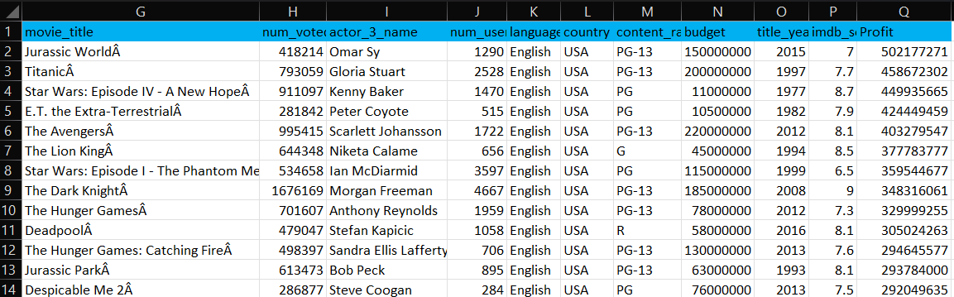

Result
B. Movies with highest profit: Create a new column called profit which contains the difference of the two columns: gross and budget. Sort the column using the profit column as reference. Plot profit (y-axis) vs budget (x- axis) and observe the outliers using the appropriate chart type.
Your task: Find the movies with the highest profit?
This formula used to get profit
Jurassic World has made the maximum profit.
The host is the outlier with budget 12,215M and loss of 12,213M

Slide 9
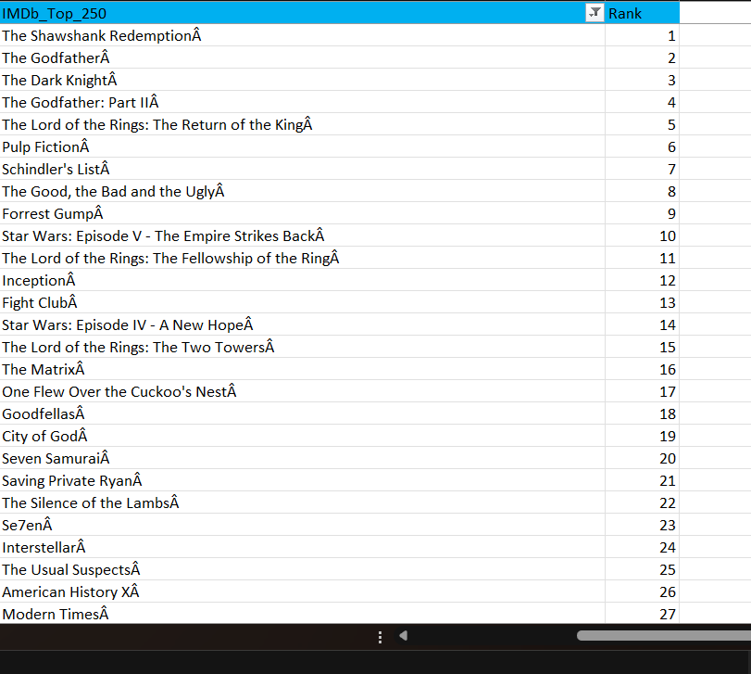


Result
C. Top 250: Create a new column IMDb_Top_250 and store the top 250 movies with the highest IMDb Rating (corresponding to the column: imdb_score). Also make sure that for all of these movies, the num_voted_users is greater than 25,000. Also add a Rank column containing the values 1 to 250 indicating the ranks of the corresponding films.
Extract all the movies in the IMDb_Top_250 column which are not in the English language and store them in a new column named Top_Foreign_Lang_Film. You can use your own imagination also!
Your task: Find IMDB Top 250
The above formula is for getting the name of the movies that have num_voted_users is greater than 25000 and than filter out movies that doen’t come under the criteria.
For ranking row function is used after sorting the imdb_score highest to lowest.
Cont.

Slide 10
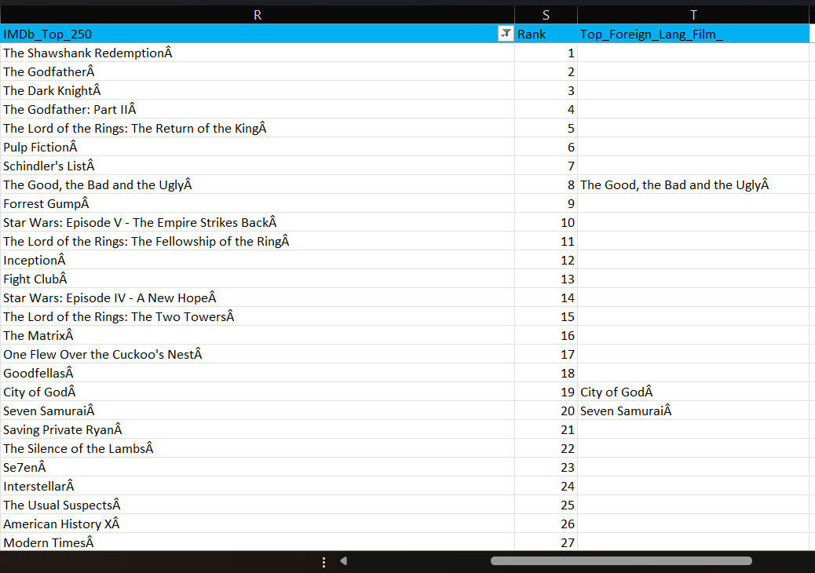

Result
In adjacent picture column T have the movies name that is extracted from Imdb_Top_250 which are not in English Language.

Slide 11
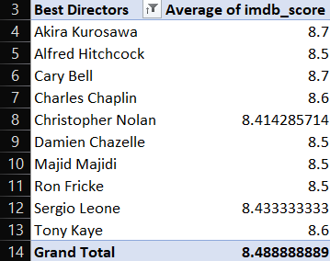
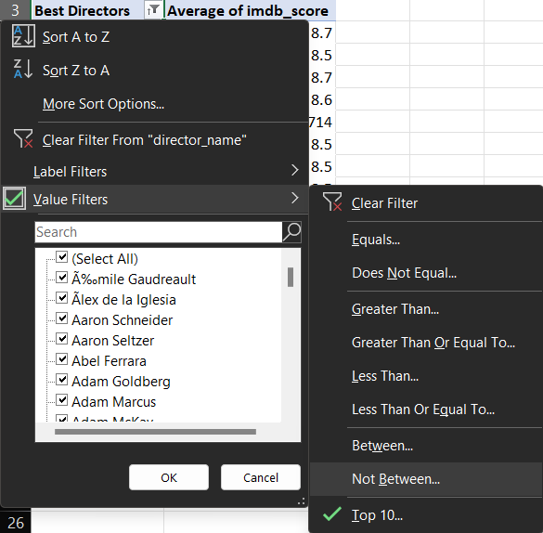
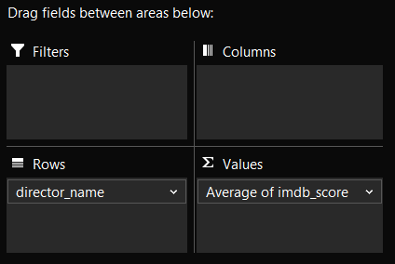
Result
D. Best Directors: Group the column using the director_name column.
Find out the top 10 directors for whom the mean of imdb_score is the highest and store them in a new column top10director. In case of a tie in IMDb score between two directors, sort them alphabetically.
Your task: Find the best directors
This could be done using Pivot Table where director_name is selected as rows and Average of imdb_score is selected as Values. Than Top 10 is selected from filter.

Slide 12
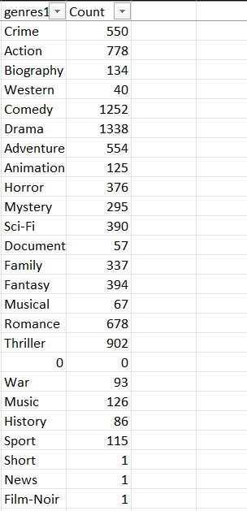

Result
E. Popular Genres: Perform this step using the knowledge gained while performing previous steps.
Your task: Find popular genres
So the most popular genre is Drama which is used 1338 times in genre.

Slide 13
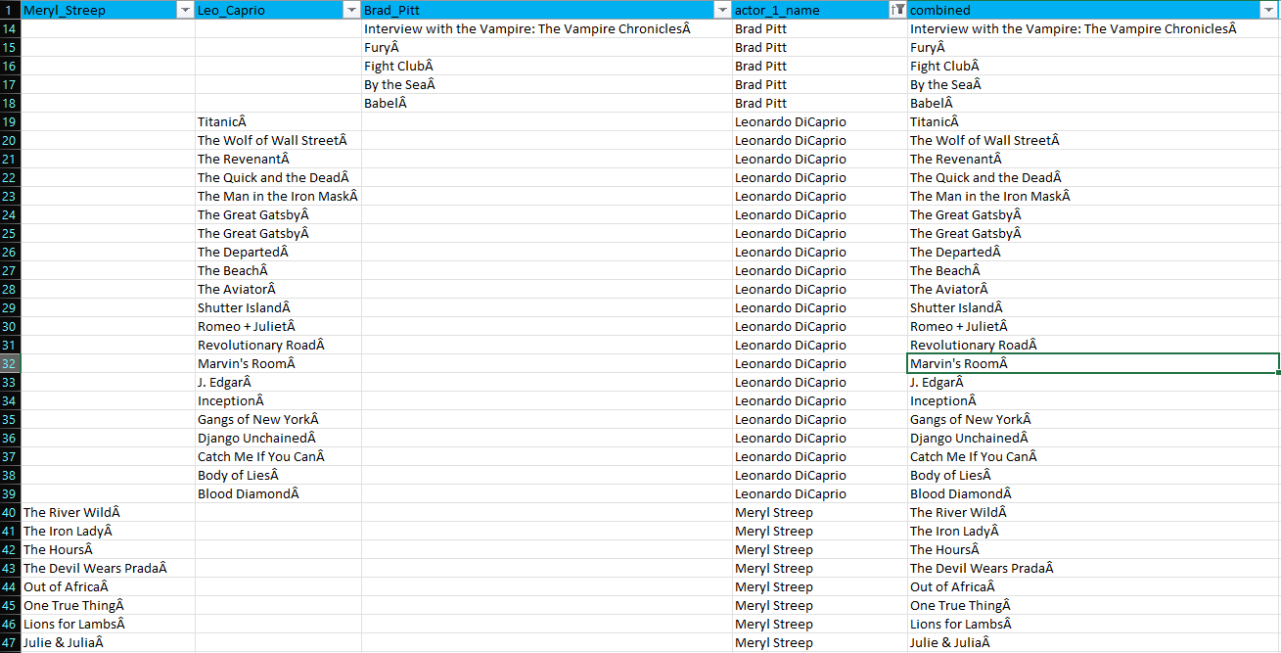



Result
Charts: Create three new columns namely, Meryl_Streep, Leo_Caprio, and Brad_Pitt which contain the movies in which the actors: 'Meryl Streep', 'Leonardo DiCaprio', and 'Brad Pitt' are the lead actors. Use only the actor_1_name column for extraction. Also, make sure that you use the names 'Meryl Streep', 'Leonardo DiCaprio', and 'Brad Pitt' for the said extraction. Append the rows of all these columns and store them in a new column named Combined. Group the combined column using the actor_1_name column.

Slide 14
Result
F. Charts: Create three new columns namely, Meryl_Streep, Leo_Caprio, and Brad_Pitt which contain the movies in which the actors: 'Meryl Streep', 'Leonardo DiCaprio', and 'Brad Pitt' are the lead actors. Use only the actor_1_name column for extraction. Also, make sure that you use the names 'Meryl Streep', 'Leonardo DiCaprio', and 'Brad Pitt' for the said extraction. Append the rows of all these columns and store them in a new column named Combined. Group the combined column using the actor_1_name column.

Slide 15
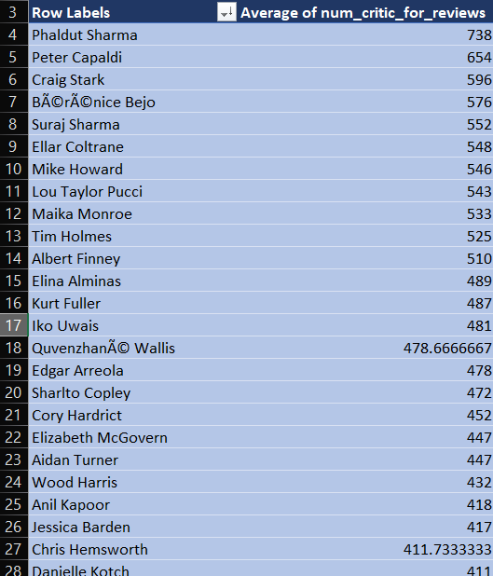
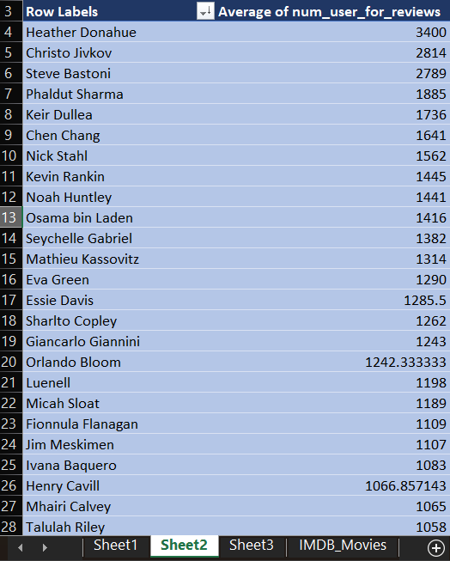
Result
Find the mean of the num_critic_for_reviews and num_users_for_review and identify the actors which have the highest mean.
Both the means are calculated using pivot table:
Actor who has the highest mean of num_critic_for_reviews is “Phaldut Sharma”.
Actor who has the highest mean of num_user_for_reviews is “Heather Donahue”.

Slide 16
Result
Observe the change in number of voted users over decades using a bar chart. Create a column called decade which represents the decade to which every movie belongs to. For example, the title_year year 1923, 1925 should be stored as 1920s. Sort the column based on the column decade, group it by decade and find the sum of users voted in each decade. Store this in a new data frame called df_by_decade.

Slide 17
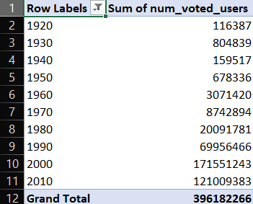
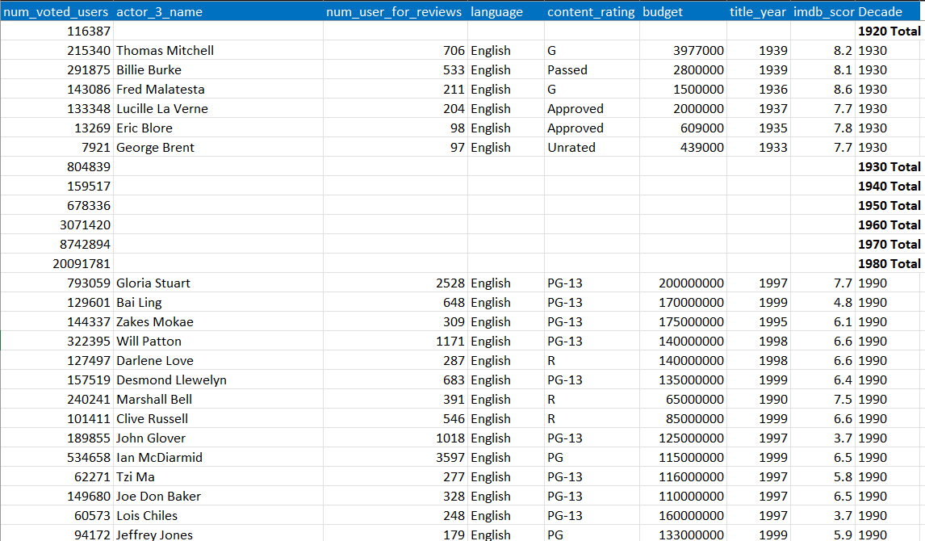

Result
Your task: Find the critic-favorite and audience-favorite actors
Adjacent formula is used to calculate the decade.

Slide 18
Result
Thank You
Connect me on:
rajatpawan@gmail.com

